Slide 1
ACE (Active Citizenship in Europe) Project No. 2013-1-GB2-GRU06-11105 4
Irem Bezcioglu Goktolga
Durdane Bayram Jacobs

Slide 2
Content
Summary of ACE Project
Icebreaker
Flags game: http://www.purposegames.com/game/285/info
Ik hou van EU game

Slide 3
EU Citizen
Any person who holds the nationality of an EU country is automatically also an EU citizen.
EU citizenship is additional to and does not replace national citizenship.

Slide 4
What rights do you have as an EU citizen?
The Treaty on the Functioning of the European Union entails the right to:
move and reside freely within the EU
vote for and stand as a candidate in European Parliament and municipal elections
be protected by the diplomatic and consular authorities of any other EU country
petition the European Parliament and complain to the European Ombudsman

Slide 5
EU citizens are entitled to other rights
The right to contact and receive a response from any EU institution in one of the EU's official languages
The right to access European Parliament, European Commission and council documents under certain conditions
The right of equal access to the EU Civil Service

Slide 6
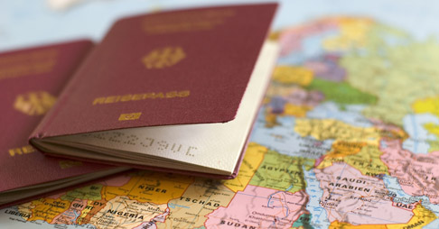
Travelling, living and working in Europe
The right to move and reside freely within the EU and not to be discriminated against on grounds of your nationality.
As an EU citizen, you have the right to move and reside freely within the EU.
http://europa.eu/youreurope/citizens/travel/index_en.htm

Slide 7
Work
As an EU citizen you can work anywhere in the EU.
If you fancied a change of scene or to live in a hotter climate then you could look to see what jobs you could do abroad.
The only types of things you couldn't do is work for the police or armed forces. You would be able to work in:
Health e.g. as a nurse
Education e.g. as a teacher
Other public services

Slide 8
Health
You can get a free European Health Insurance Card (EHIC) which means it will help cover your medical costs if you are ill while you are abroad in Europe.
e.g if you break your arm while on holiday in Spain, this card will help you keep your medical costs down.

Slide 9
Exercising your rights
The right to vote and stand as a candidate in elections
When living in another EU country, you have the right, as an EU citizen, to vote and stand as candidate in municipal and European elections held in that country, under the same conditions as nationals. http://europa.eu/youreurope/citizens/residence/worker-pensioner/elections/index_en.htm
You do need to be 18 years old to vote though.

Slide 10
The right to petition
The right to petition allows you to raise concerns or complaints with the European Parliament.
You can ask the Parliament to address either a personal need or grievance, or a matter of public interest.

Slide 11
The right to complain to the Ombudsman
For grievances concerning ‘mal-administration’ by an EU institution or body, you can complain to the Ombudsman.
You can also contact EU institutions and advisory bodies directly, and you are entitled to receive a reply in any of the EU’s 23 official languages.

Slide 12
The right to consular protection for unrepresented EU citizens
When in a non-EU country and in need of help, as an EU citizen you are entitled to consular protection from the embassy or consulate of any other EU country under the same conditions as nationals of that country.
Assistance may be provided in situations including death, accident or illness, arrest or detention, violent crime and repatriation.

Slide 13
The right to ask the Commission to propose new legislation
The European Citizens’ Initiative allows you to ask the European Commission to prepare a proposal for a legal act. The petition must be signed by at least 1 million citizens from at least one quarter of EU countries.

Slide 14
Fundamental rights
The Treaty of Amsterdam introduced a way to take action against an EU country that violates its citizen's fundamental rights. It also states that discrimination by nationality, gender, race, religion, age and sexual orientation is unacceptable.
It also promotes equality between men and women, data protection rights, right to environmental protection, and the rights of children, amongst other things.

Slide 15
Education
As EU citizens, your children are entitled to attend school in any EU country under the same conditions as nationals of that country.
They have the right to be placed in a class with their own age group, at the equivalent level to their class in your country of origin - regardless of their language level.

Slide 16
Education
If you are an EU national migrating to another EU country for work, your children are entitled under EU law to receive free language tuition in your new home country to help them adapt to the school system there.

Slide 17
Study abroad with Erasmus+
If you are a student, you may have a chance to do part of your studies abroad or complete a traineeship in a company through Erasmus+.
If you are interested in doing part of your studies abroad, you should first contact your own university.
When you go abroad to study via Erasmus+ :
you don't have to pay registration or tuition fees to your host university
your studies abroad count as an integral part of your degree
you get an EU grant towards living and travel expenses.

Slide 18
Working while studying
As an EU citizen, you will have the same right to work while studying as nationals of that country. You will not need a work permit, even to work full-time.
Exception - Croatian nationals still face temporary restrictions on working in the EU.
Several countries allow you to work an unlimited number of hours per week. Others apply limits per term, or per year.
More on working in another EU country.

Slide 19
Taxes and social security
If you live in another EU country for more than 6 months a year there (183 days) you will be considered tax-resident there. Consequently, if you work while studying, you will have to pay taxes and social security contributions on income earned in the country where you study.
The country where you study could also tax income earned in a different country, for instance from any summer jobs you may get in your country of origin. You may have to report such income and, in some cases, pay tax on it in the country where you study.
Be aware that many - but not all - EU countries have agreements to avoid double taxation. These agreements may in some cases determine which country you should pay tax to.

Slide 20
Sample story
Joost is a Dutch student who moved to the UK to study. He works part-time at a restaurant on a contract under English law. His employer deducts taxes and social security from his monthly pay checks and pays contributions for him to the UK authorities.
During his summer holidays, Joost works full-time in his native town in the Netherlands. His employer there pays contributions for him to the Dutch tax authorities.
Joost, who is a UK resident for tax purposes, can either request a refund from the Dutch authorities and then pay the applicable income taxes in the UK, or declare the income earned in the Netherlands and the taxes already paid there to have a tax discount from UK authorities instead.

Slide 21
Traineeship
Erasmus+ studies and traineeships abroad
If you are a university student, you may be able to go on an Erasmus+ exchange abroad for part of your studies or for a traineeship in a company.
If you are in vocational education or training, or have just finished your training, and want to develop your job skills and employability through a traineeship abroad, the EU's 'Erasmus+' programme may provide financial support.

Slide 22
Recognition of your study period abroad
Your home university must recognise your period of study abroad as counting towards your degree, provided you complete the study programme agreed in advance of your exchange.

Slide 23
Denied boarding?
When passengers are denied boarding on a flight, airlines are obliged to first seek volunteers to give up their reservation in exchange for certain benefits. In addition, the air carrier must also offer volunteers the choice between a full refund and re-routing.

Slide 24
Cancellation
The airline must offer you the choice between:
reimbursement of your ticket within seven days;
re-routing to your final destination under similar conditions;
if necessary, care (phone call, refreshments, food, accommodation, transportation to the accommodation).

Slide 25
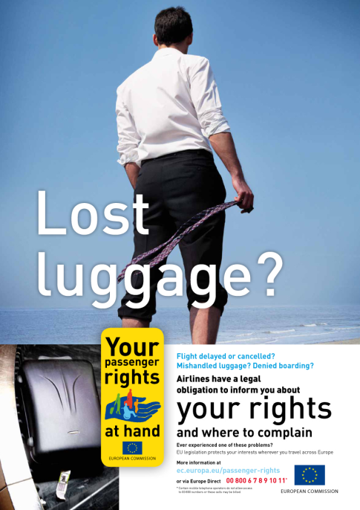
Baggage
If your baggage is lost, damaged or delayed, you may be entitled to compensation limited to about €1,220.

Slide 26
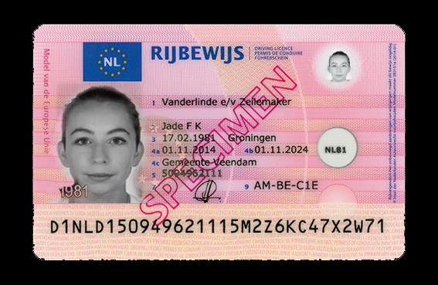
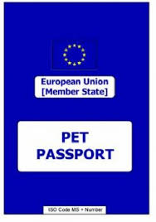
Driving licence
Your driving licence is valid across the EU
You can even take your cat or dog across
Europe provided you have a European
pet passport.

Slide 27
Consumer rights – do you know yours?
Michel, who lives in France, ordered a digital camera from a German website. He paid €300 in advance for the camera and was then informed that the German trader had sent the camera through the post.
However, the camera never arrived. Michel tried to contact the trader several times but, when he got no response, he turned for help to the European Consumer Centre (ECC) in France.
The French ECC liaised with the German online consumer body, which was able to go straight to the trader. As the trader had no proof of postage, he was obliged to provide Michel with a new camera.

Slide 28
If you have similar problems
The EU-wide network of European Consumer Centres (ECC-Net) offers you free consumer help and advice.
http://ec.europa.eu/consumers/ecc/index_en.htm
Europe Diary
http://ec.europa.eu/consumers/europadiary/index_en.htm
http://ec.europa.eu/0-18/wrc_index_en.jsp?main=true&initLang=EN

Slide 29
Extra examples
I am French and I plan to travel to Austria. Do I need to carry a valid travel document with me even if both countries belong to the Schengen area?
Yes. Even though systematic border controls have been abolished between Schengen countries, spot checks are still possible, at the border and inside the territory of the country of destination. Besides, if you are travelling by plane or by boat, the carrier is likely to ask for valid French ID card or passport.

Slide 30
I am Italian and my husband and children are Colombian nationals. Will they need a visa to travel with me from Brazil, where we live, to Spain?
They will need a visa because Colombia is on the list of countries whose nationals require a visa. However, as family members of an EU citizen travelling with you, they have a right to obtain the visa and can get it free of charge and under an accelerated procedure. Besides, a uniform short stay visa will be valid for all countries of the Schengen area.

Slide 31
Extra examples
If my flight was cancelled due to unsafe flight conditions, can the airline deny me reimbursement and compensation?
Compensation will not apply if the circumstances qualify as extraordinary, but in any case you are entitled to reimbursement of your ticket (in full or for the part that you have not used) or rerouting, at your choice, and the airline is obliged to provide you with assistance (e.g. Reasonable refreshments and meals, means of communication) while you are waiting for re-routing.

Slide 32
Extra examples
Is there a formality I need to be aware of if I want to carry a large amount of cash with me on a trip to another EU country?
Yes. If you travel to a country outside the EU with € 10.000 or more in cash (or its equivalent in other currencies) you must declare it to the customs authorities. If you enter the EU with the same amount, you are under the same obligation. Within the EU there is no limit to the free movement of capital but there are some national regulations that impose formalities on people carrying large sums of money.

Slide 33
THANK YOU!

